Slide 1
HEALTHY LIFE WITHOUT OBESITY VIA SPORT
MEETING IN SPAIN

Slide 2
SURVEY RESULTS
Assotiation for The Disabled „Joy of Life”
Target group - participants of the occupational therapy workshops.
35 people (13 women, 22 men)

Slide 3
NR | SEX | AGE | HEIGHT | WEIGHT | TYPE OF DISABILITY | HEALTH PROBLEMS | SPORT | REGULARY / HOW OFTEN | WHY DONT PRACTISE SPORT | LEISURE ACTIVITIES
1 | M | 20 | 178 | 84 | mental retardation | hypertension | aerobics | 1 a week | - | walking, TV
2 | M | 50 | 155 | 55 | mental retardation | - | stationary bike, aerobics | every day | - | walking, TV
3 | M | 33 | 176 | 72 | mental retardation | - | soccer | 1 a week | - | the book, helping on the farm
4 | M | 31 | 164 | 117 | mental retardation | diabetes, varicose leg | stationary bike, aerobics | 2 a week | - | helping on the farm
5 | M | 24 | 160 | 60 | mental retardation | - | soccer | 1a week | - | sewing, walking, TV
6 | M | 37 | 162 | 54 | mental retardation | - | stationary bike, aerobics | every day | - | helping on the farm
7 | W | 23 | 166 | 80 | mental retardation | epilepsy | aerobics, bicycle | 2 a week | - | knitting, TV
8 | M | 47 | 178 | 74 | mental retardation | - | stationary bike, aerobic | every day | - | helping on the farm, walking
9 | M | 31 | 168 | 71 | mental retardation | epilepsy | stationary bike, aerobics | every day | - | walking, TV
10 | M | 34 | 182 | 124 | mental retardation | epilepsy,varicose leg,diabetes | - | - | healthy problems | helping on the farm

Slide 4
NR | SEX | AGE | HEIGHT | WEIGHT | TYPE OF DISABILITY | HEALTH PROBLEMS | SPORT | REGULARY / HOW OFTEN | WHY DONT PRACTISE SPORT | LEISURE ACTIVITIES
11 | M | 34 | 175 | 71 | mental retardation and physical problems of movement | - | soccer | 1 a week | - | help on home
12 | W | 34 | 149 | 61 | mental retardation | - | aerobics | 2 a week | - | helping on the farm
13 | W | 45 | 160 | 89 | mental retardation | mental disorders | stationary bike | ewery day | - | TV
14 | M | 41 | 179 | 95 | mental retardation | - | soccer | 1 a week | - | -
15 | W | 35 | 168 | 76 | mental retardation | - | aerobics, stationary bike | 2 a week | - | the book, wolk, arts hobby
16 | M | 34 | 181 | 79 | mental retardation | - | bicycle, table tennis | 2 a week | - | wolk, TV, help on home
17 | M | 48 | 192 | 127 | mental retardation | hypertension | - | - | healthy problems
18 | W | 33 | 178 | 120 | mental retardation | mental disorders | - | - | healthy problems | help on home
19 | W | 40 | 154 | 53 | mental retardation and physical problems of movement | hypertension | aerobics | every day | - | sewing, the book, TV
20 | M | 42 | 178 | 80 | mental retardation | neurological disorders | - | - | lack of motivation | walking

Slide 5
NR | SEX | AGE | HEIGHT | WEIGHT | TYPE OF DISABILITY | HEALTH PROBLEMS | SPORT | REGULARY / HOW OFTEN | WHY DONT PRACTISE SPORT | LEISURE ACTIVITIES
21 | W | 34 | 182 | 71 | mental retardation | - | aerobics | 2 a week | - | the book, TV, walking
22 | M | 30 | 188 | 98 | mental retardation | - | soccer, bicycle | 2 a week | - | wolk, helping on the farm
23 | W | 27 | 148 | 72 | mental retardation | - | - | - | lack of motivation | TV
24 | M | 39 | 152 | 98 | mental retardation | bone structure | - | - | healthy problems | TV
25 | M | 34 | 186 | 66 | mental retardation | mental disorders | bicycle, table tennis | 2 a week | - | newspeaper, TV
26 | W | 34 | 156 | 71 | mental retardation | - | table tennis, aerobics | 2 a week | - | knitting, TV
27 | W | 34 | 158 | 73 | mental retardation | mental disorders | table tennis, aerobics | 2 a week | - | knitting, TV
28 | W | 39 | 145 | 65 | mental retardation | - | table tennis, aerobics, bicycle | 2 a week | - | help on home
29 | M | 42 | 175 | 94 | mental retardation and physical problems of movement | - | stationary bike | 2/3 a week | - | helping on the farm
30 | M | 23 | 160 | 58 | mental retardation | - | table tennis, bicycle | 2/3 a week | - | helping on the farm

Slide 6
NR | SEX | AGE | HEIGHT | WEIGHT | TYPE OF DISABILITY | HEALTH PROBLEMS | SPORT | REGULARY / HOW OFTEN | WHY DONT PRACTISE SPORT | LEISURE ACTIVITIES
31 | M | 22 | 174 | 58 | mental retardation | - | bicycle,soccer | 2/3 a week | - | help on home, newspeaper, TV
32 | M | 21 | 163 | 62 | mental retardation | diabetes | bicycle, soccer | 2/3 a week | - | walking, TV
33 | W | 31 | 164 | 98 | mental retardation | mental disorders | - | - | lack of motivation, healthy problems | walking, TV
34 | M | 25 | 158 | 63 | mental retardation | - | bicycle, aerobics | 2/3 a week | - | walking, TV
35 | K | 22 | 158 | 52 | mental retardation | epilepsy | aerobics | 2 a week | - | helping on the farm, TV

Slide 7
SEX

Slide 8
HEALTHY PROBLEMS

Slide 9
HEALTHY PROBLEMS (%)
NOTES
A - metabolic disorders (diabetes)
B - cardiovascular disorders (hypertension, varicose veins)
C- mental disorders
D- neurological disorders / epilepsy
E - diseases of the skeletal system

Slide 10
TYPE SPORT

Slide 11
REGULARY/HOW OFTEN

Slide 12
LEISURE ACTIVITIES

Slide 13
Rehabilitation workshop
The workshop activities cover, among others; general development and improvement exercises at ladders and on mattresses, elements of corrective physical exercises, weight training for separate parts of muscles (with the use of atlas), training in separate sport disciplines: among others table tennis, basket ball,football, elements of light athletics.

Slide 14
Rehabilitation workshop
In the workshop program, special attention is paid to rational dosing of the effort of rehabilitated people, connecting the exercises with correct breathing, correct position of the exercises, shaping the proper posture, relaxation-unwound elements will be introduced.

Slide 15
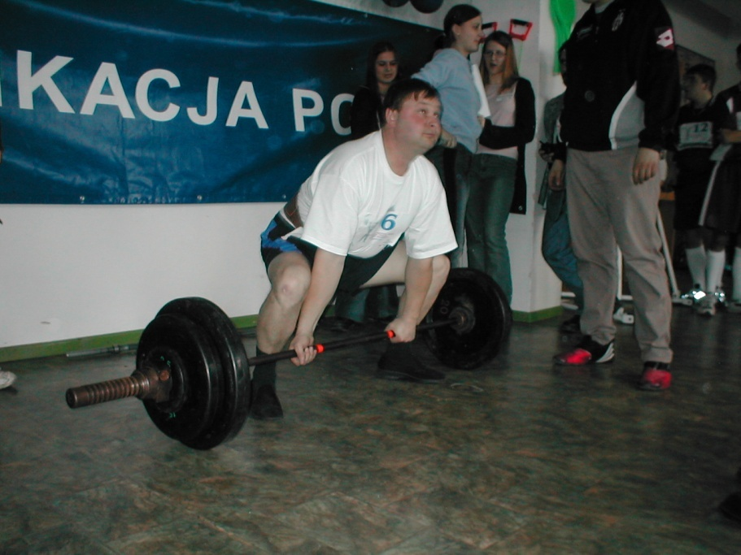
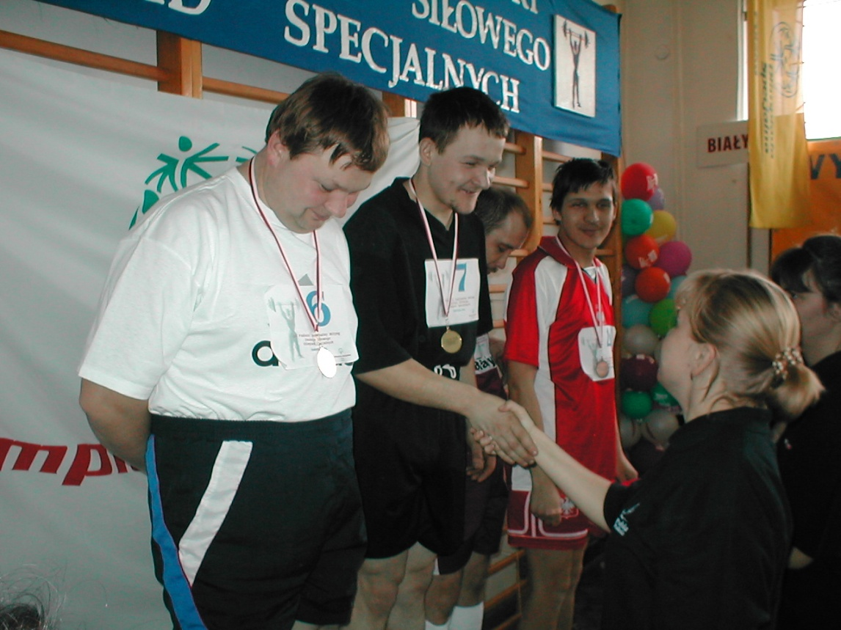

Slide 16
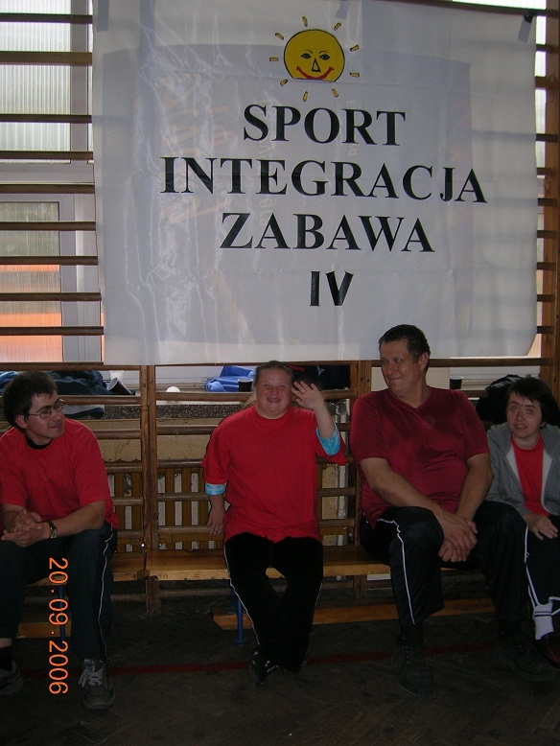
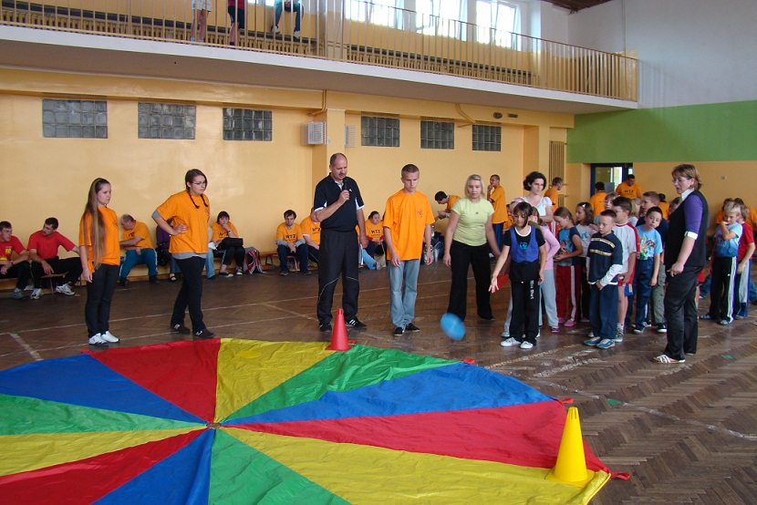

Slide 17
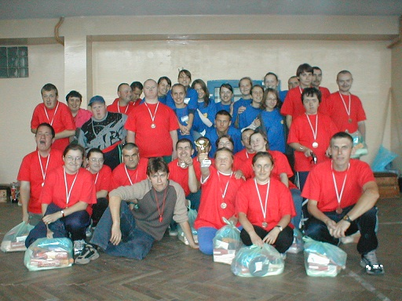

Slide 18
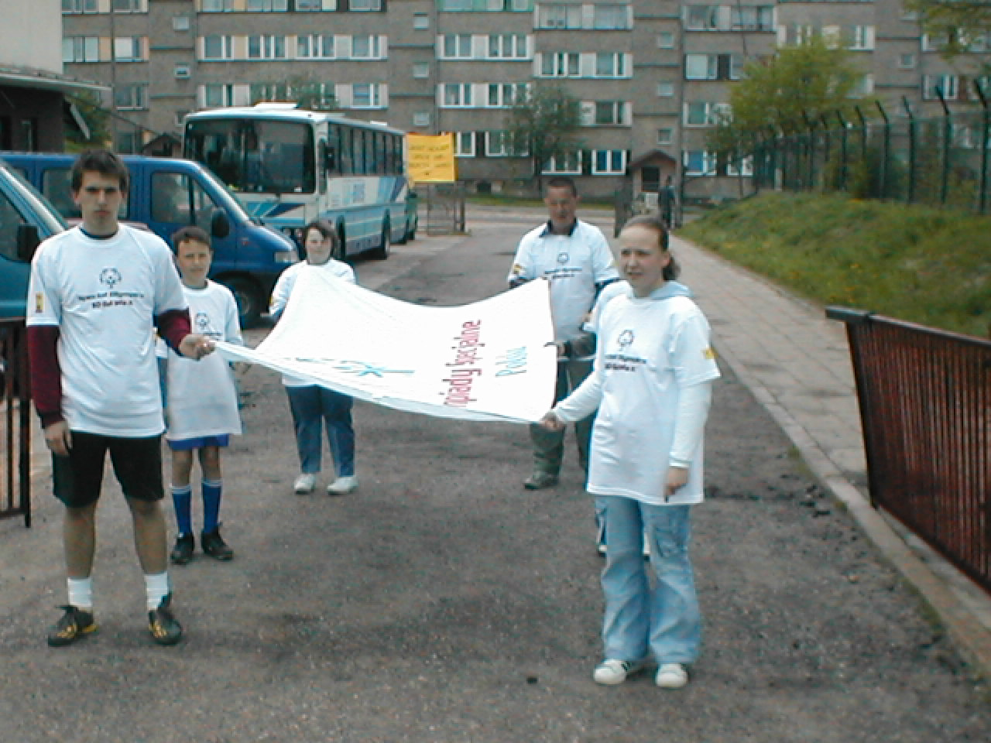
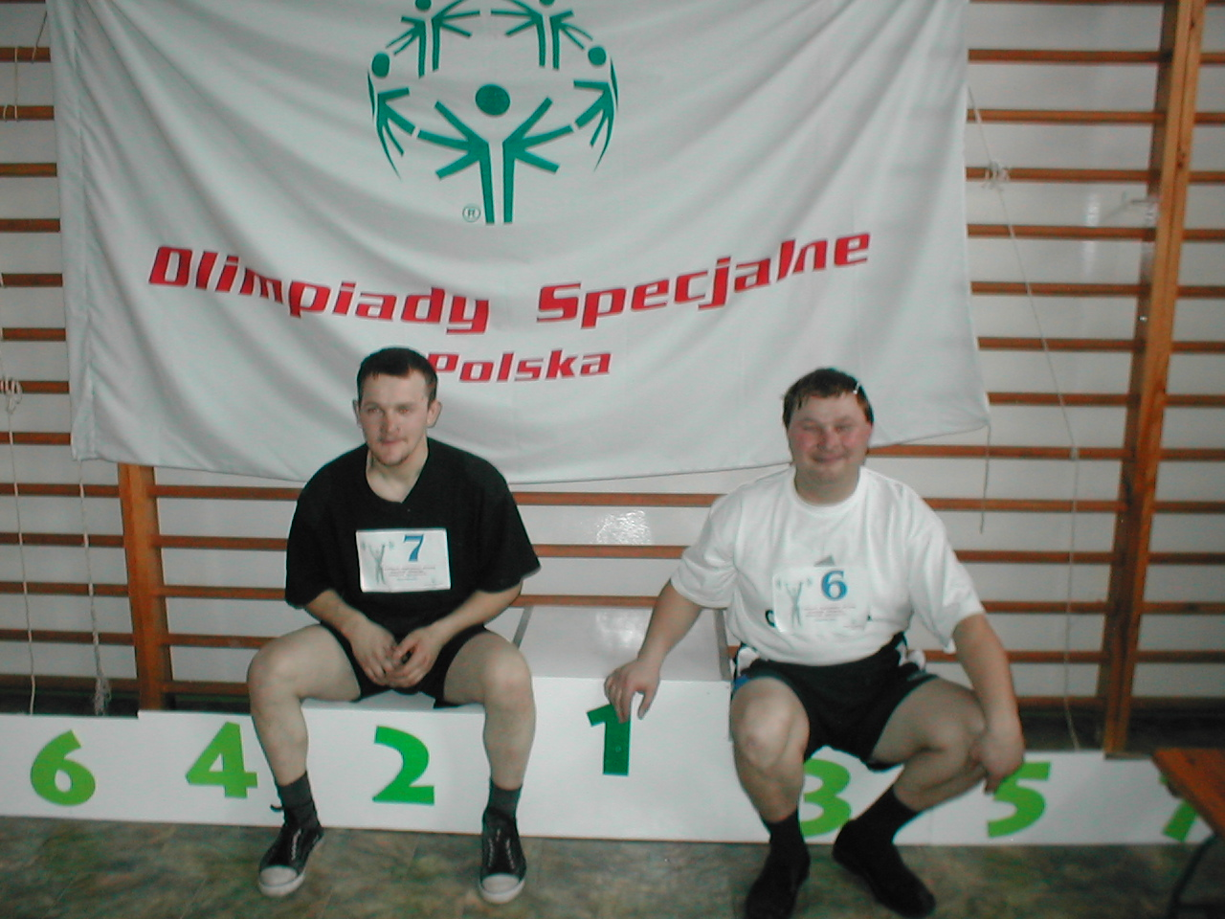

Slide 19
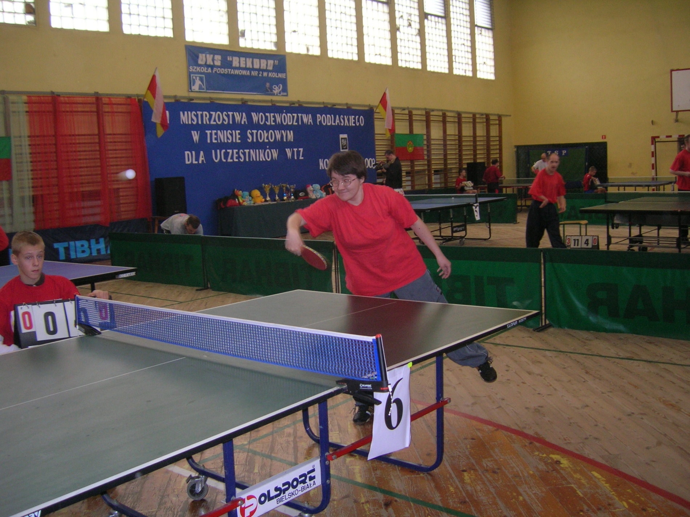

Slide 20
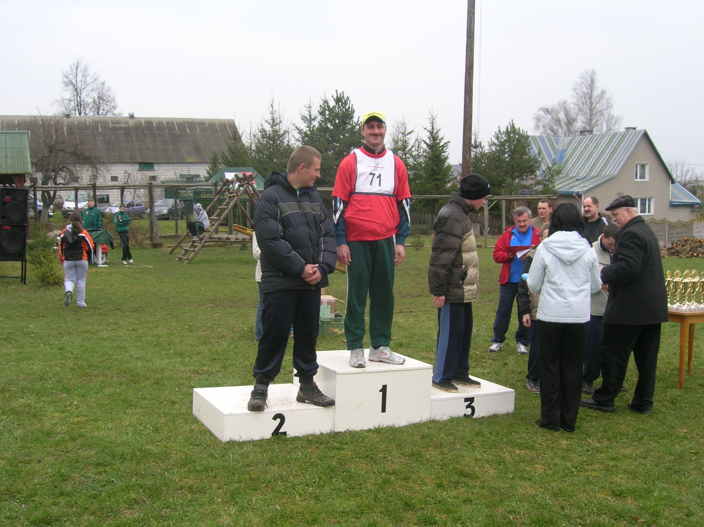

Slide 21
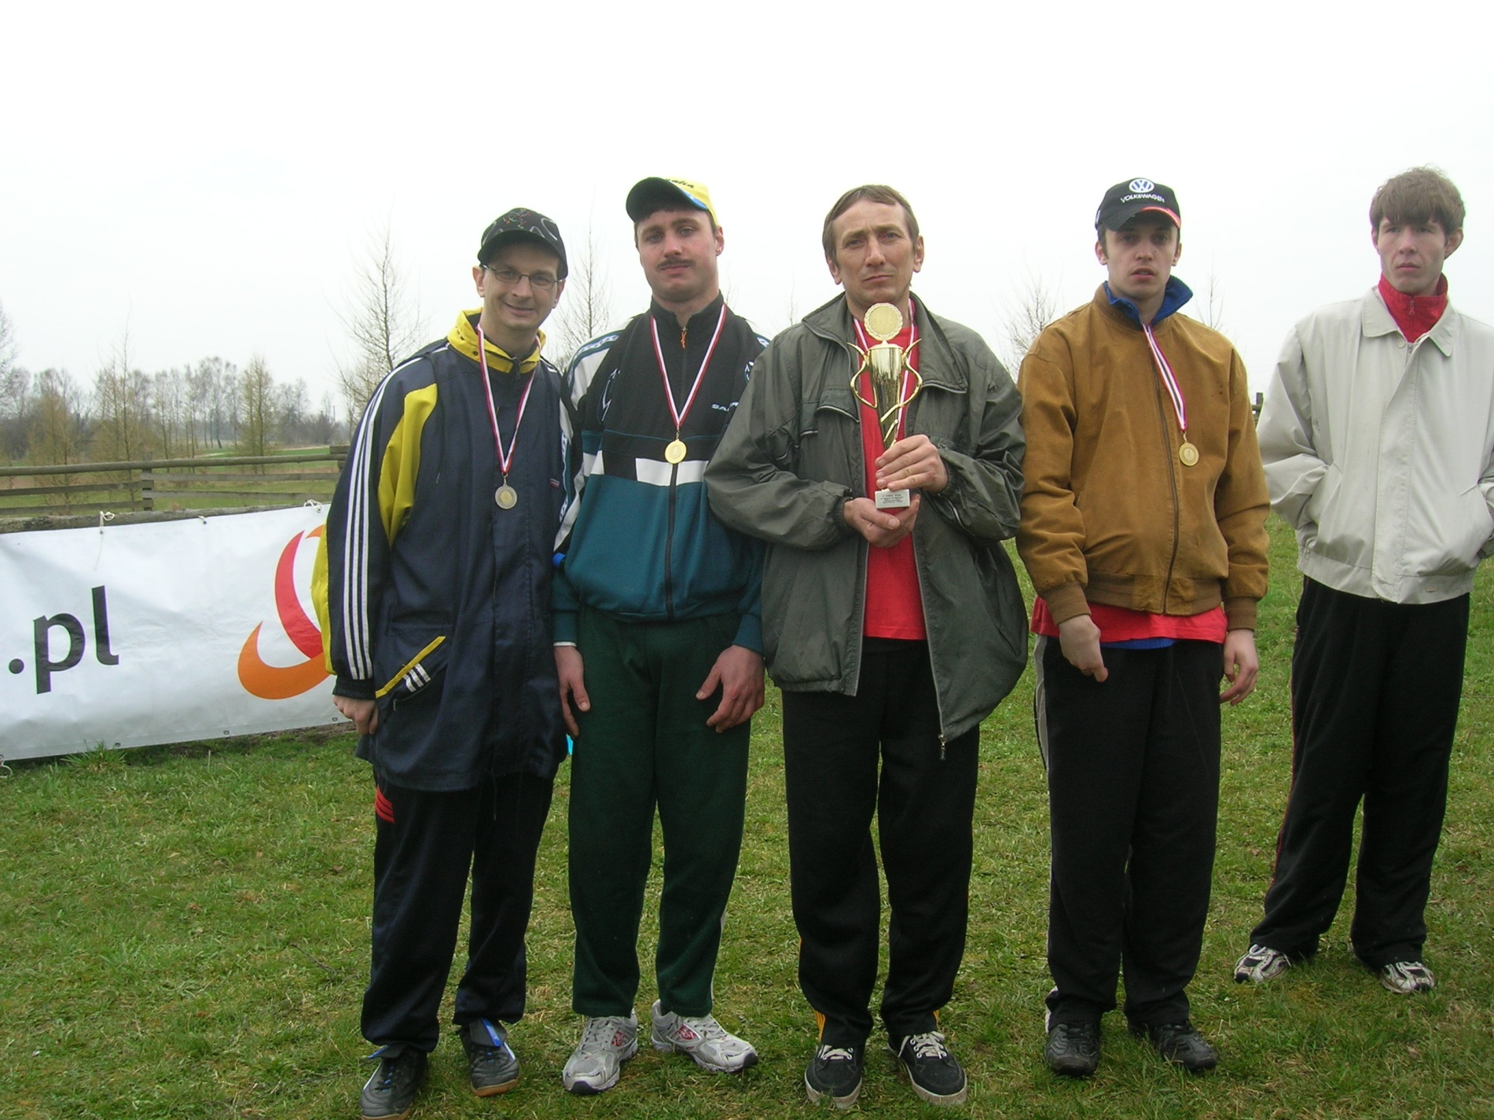

Slide 22
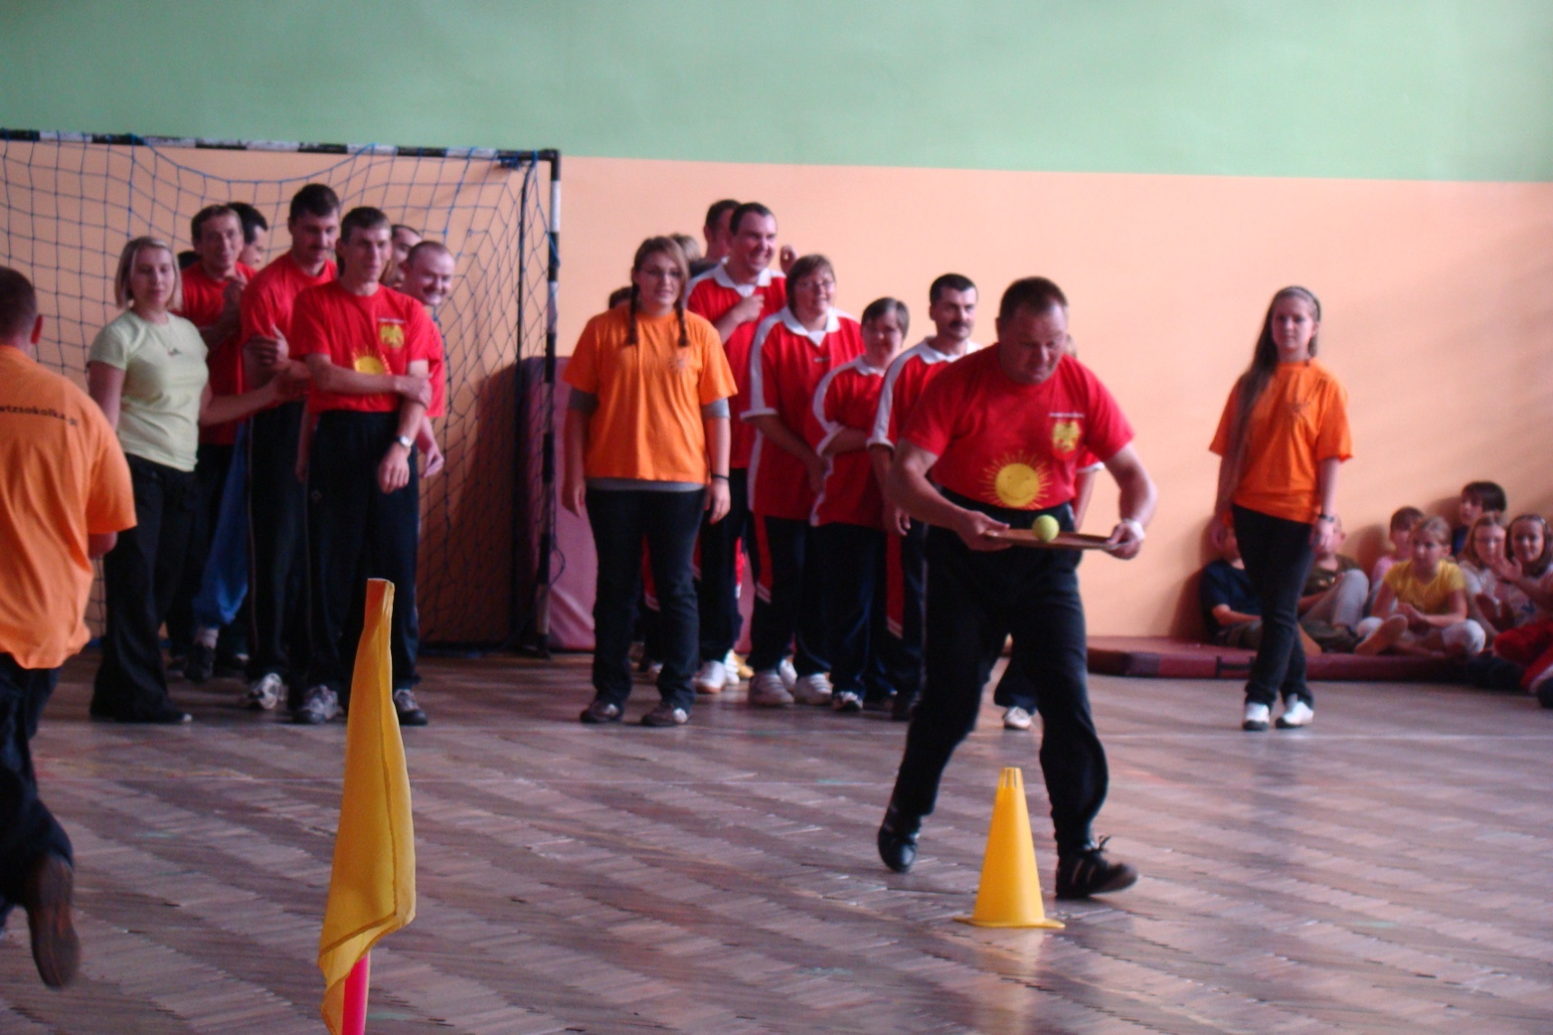

Slide 23
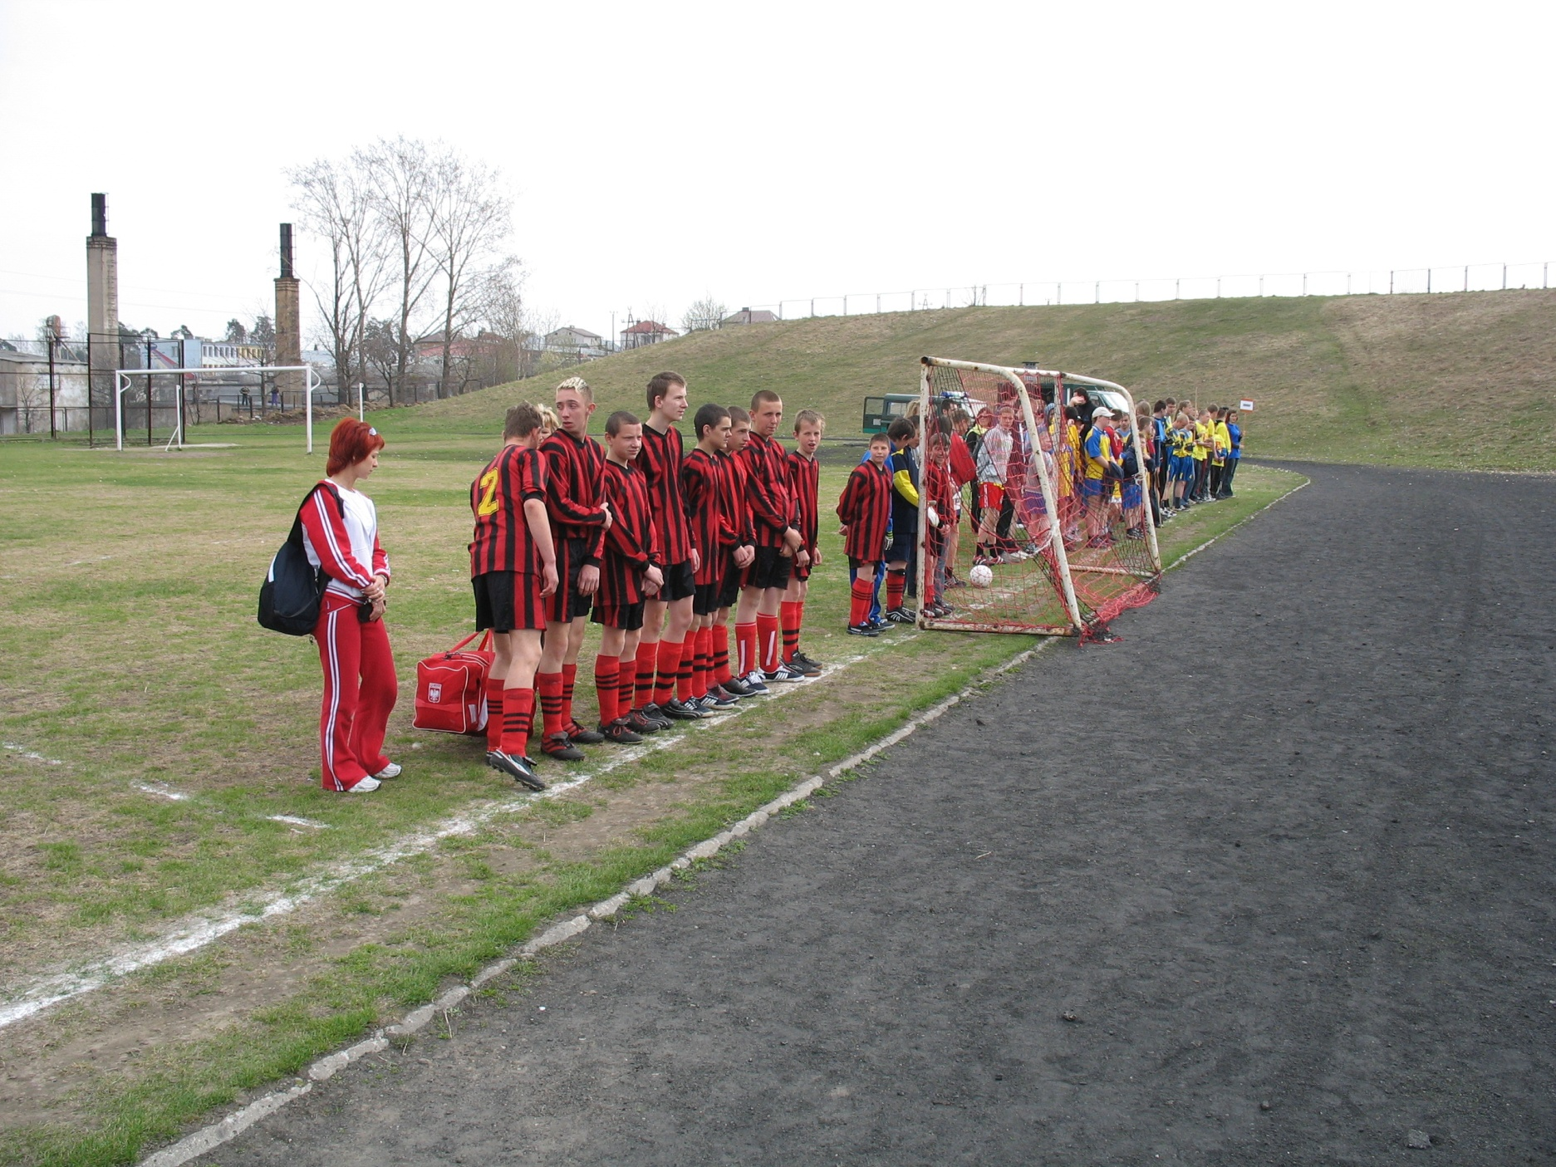

Slide 24
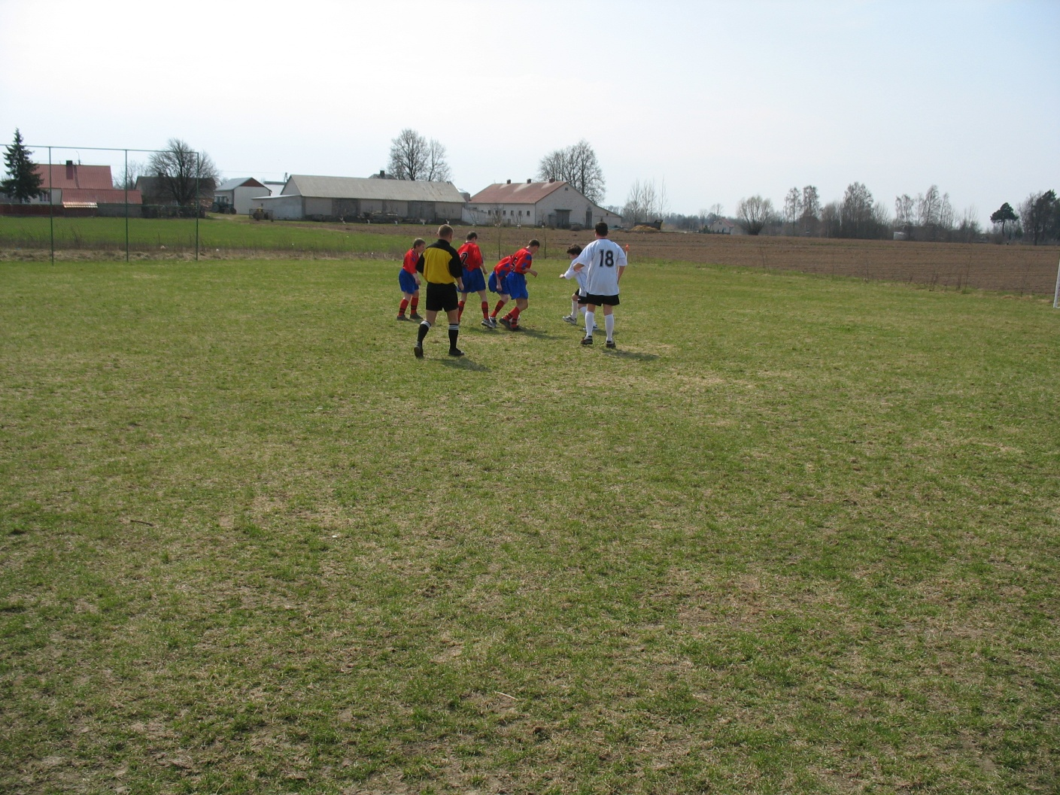
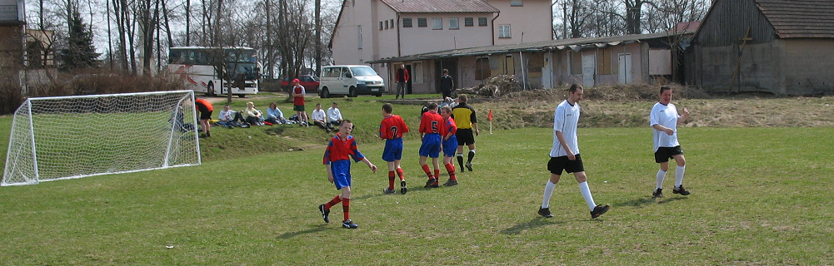

Slide 25
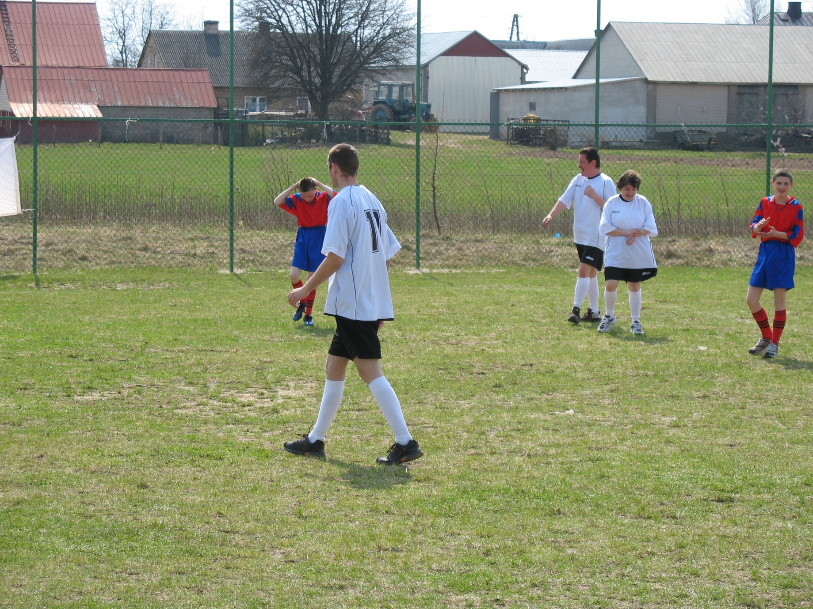

Slide 26
Thank you for your kind attention

