Slide 1
HEALTHY LIFE WITHOUT OBESITY VIA SPORTS
MEETING IN POLAND

Slide 2
healthy lifestyle

Slide 3

healthy lifestyle
WHAT MUST WE DO? what is important?
active and passive recreation
physical activity
planned nutrition
personal hygiene
joy, satisfaction, positive thinking

Slide 4
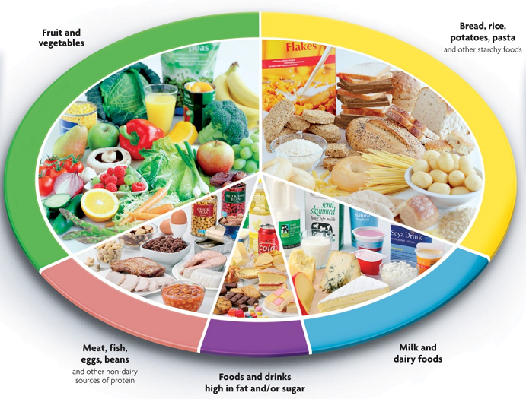
Principles of feeding by Fork Healthy Nutrition:

Slide 5
Principles of feeding by Fork Healthy Nutrition:
eat lots of fruits and vegetables - they should be the main component of your diet
eat lots of cereal products - bread, rice, potatoes, pasta and other starchy foods. Choose whole grains
eat daily milk and dairy products
eat small amounts of meat daily / fish / eggs / beans
Limit intake of foods high in fat and simple sugars

Slide 6
rules of healthy eating
1. Eat 4-5 meals a day, without " snacking " between meals.
2. Best to eat regularly at the same times
3. Thoroughly chew and chew foods that we eat
4. Drink fluids before meals or two hours after a meal.
5. Consume products with low glycemic index and low glycemic load
6. Avoid excessive amounts of cholesterol
7. Eat unprocessed products containing natural vitamins, minerals, fiber, essential fatty acids

Slide 7
rules of healthy eating
8. Keep the acid - base balance of the body
9. Limit your intake of foods with additives artificial colors , preservatives or other synthetic additives
10. Eat the last meal at least two hours before bedtime
11. Avoid plants collected outside the growing season ( spring vegetables )

Slide 8
rules of healthy eating
12. Keep moderation in the consumption of both butter and margarine.
13. Consume
14. Try to limit the amount of coffee consumed and the usual tea .at least 1.5 liters of water per day.
16. Try to limit the amount of consumed white flour.
17. Try to limit the intake of sugar and aspartame.
18. Try to limit the amount of salt and monosodium glutamate .

Slide 9
The diet for an athlete
The diet for an athlete should be tailored to gender, age and the type of sport practiced . It is also important information about the nature , whether it is a sport endurance , strength , sprint or another . The construction of the athlete's diet also influences whether it is in the initial phase of training and the regular sports.

Slide 10
The diet for an athlete
The most important nutrients that the athlete should provide your body are: protein and carbohydrates. Many people who practice sports regularly takes special dietary supplements. They provide essential nutrients , which affect muscle growth . What should the diet for athletes ?

Slide 11
I Principles diet for athletes
The menu for athletes should include mostly large amounts of carbohydrates and protein. Carbohydrates are burned during a workout and afterwards consumed in the regeneration of muscle fibers.

Slide 12
I Principles diet for athletes
Carbohydrates should provide 55-60% of total energy demand during the day. Therefore, the menu for athletes should include large amounts of products such as cereal , brown rice , pasta, whole wheat , oatmeal . By eating them at every meal , your body will have enough power for a period of exercise.

Slide 13
I Principles diet for athletes
Do not eat or drink since immediately before training , but about 2-4 hours before you exercise. For example, diet for women athletes should be on three hours before exercise include the following products :
chicken with rice and salad ;
wheat flakes , oats or muesli with milk or yogurt ;
fish with vegetables and potatoes ;

Slide 14
II High protein diet for an athlete
Proteins are substances which are made all the organs and tissues of the body . After eating the meal, the protein contained therein is digested in the gastrointestinal tract and in the form of amino acids are absorbed into the blood.

Slide 15
II High protein diet for an athlete
Physical exercise results in an increased demand for protein, but keep in mind that the greatest amount of this nutrient the body should be provided before training. Athlete's diet should contain between 250 grams to 300 grams of protein a day, but the amount may be increased in the case of sports such as bodybuilding, discus throw , shot put .

Slide 16
II High protein diet for an athlete
The menu for athletes should include foods rich in complete protein , namely:
meat and meat products - during the day you need to eat at least three meals containing chicken, lean beef and veal , preferably in the form of boiled or roasted . When choosing meats, should be guided by the content of meat in them. The best are those that have in its composition more than 70 % of the meat . Only then can we make sure that we eat a meal that will provide complete protein , not just fat or carbohydrates.

Slide 17
II High protein diet for an athlete
fish - are the best alternative for meat animal protein in the diet of fish athlete should occur at least several times a week. Omega -3 fatty acids found in fish are necessary for proper construction of cells, including muscle .
milk and dairy products - in addition high in protein are an important source of easily absorbable calcium, which is essential in the physiology of muscle contraction and bone structure .
eggs - in addition to high amounts of protein are a source of vitamin D, which is responsible for the proper management of calcium in the body , as well as the source of lecithin , which is building cell membranes and myelin sheaths of the nerves that protect them from damage.

Slide 18
III Principles of nutrition for active people
Meals should be easy to digest, so as not littered long in the stomach . Also, the volume of food should not be large. Limitation products are: beans, peas , lentils , cabbage , onions , garlic, fried foods, spices - vinegar , pepper , curry, paprika , allspice, bay leaf and mustard.

Slide 19
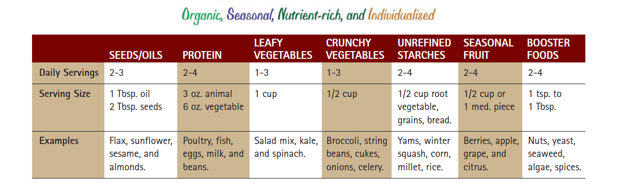
A Rejuvenating food system by edward bauman

Slide 20
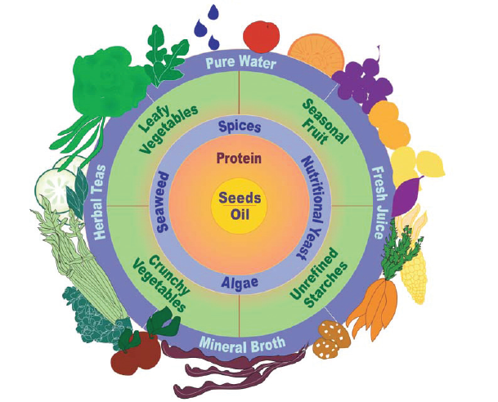
Eating 4 healthly

Slide 21
IV Sample menu for an athlete
Persons performing intense exercise can eat as follows:
1) EX:
The first breakfast (350 calories): two small slices of whole grain bread (100 g) beef Sopot (50 g), two raw cucumbers, a tomato (100 g), a glass of kefir (200 g).
The second breakfast (250 calories): one whole-wheat bread (60 g), pasta (half-fat cottage cheese - 80 g, grated cucumber - any quantity, spices).
Lunch (450 calories): Roasted chicken fillet (200 g) green beans (300 g), brown rice (50 g).
Tea (100 calories), one banana (100 g).
Dinner (300 calories): cauliflower cooked (300 g), fried egg on 5 g of sunflower oil, one slice of whole-wheat bread.

Slide 22
IV Sample menu for an athlete
2 EX:
1 BREAKFAST :1/2 graham spoon rural cottage cheese, herbs for sprinkling, a cup of coffee with milk;
2 BREAKFAST: Salad 2 cups cooked potatoes and beans jaś sauce with a little plain yogurt (125 g) and a teaspoon of mustard, seasoned with pepper and basil, glass of carrot juice, fruit;
LUNCH: salmon steak (200 g) flavored with lemon, baked in foil, steamed vegetables (with a spoon of olive oil): zucchini, red bell pepper, 2 tomatoes, spoon fennel, Kaiser, a glass of mineral water.
AFTERNOON SNACK: 1 kiwi fruit with cheese (kiwi chill, chop down the tip, pulp, mix with 1 teaspoon of lean cottage cheese)
DINNER: tuna salad (120 g tuna in gravy mix with 2 tablespoons of corn and 2 tablespoons of cooked rice and season to taste with salt and pepper), 1 cup of fruit juice

Slide 23
IV Sample menu for an athlete
The diet for an athlete is one of the cornerstones of an effective workout. Using diet for an athlete creates the possibility of developing muscle mass, but also avoids the state of weakness and exhaustion that can occur with increased physical exertion.
I recommend a simple method of visualization - the method of the plate. Each and every meal we have to imagine a plate. Then it is divided into four parts. Half of each meal to be vegetables.

Slide 24
sport

Slide 25
forms of stimulation of physical activity of people with disabilities
Through play,
By playing,
By teaching
By working.

Slide 26
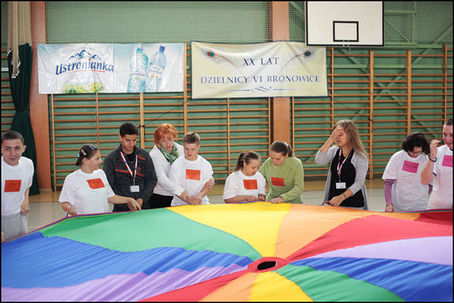
through play
the use of music:
team building,
discos,
having fun outdoors in Air,
walks,
Traditional fun with elements of dance
And
hippotherapy
hydrotherapy

Slide 27
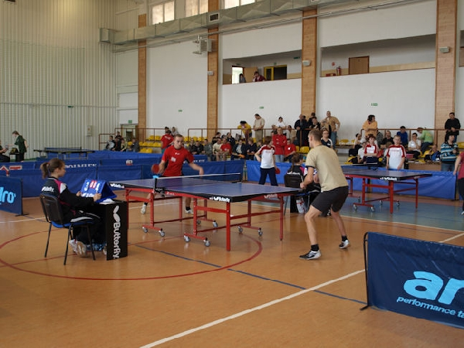
By playing
football
basketball
table tennis
volleyball

Slide 28
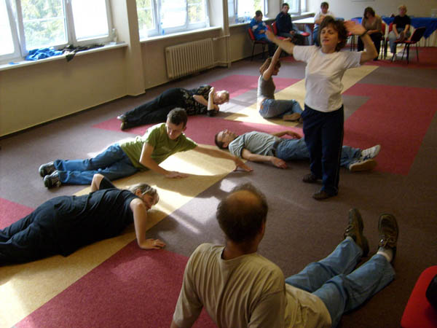
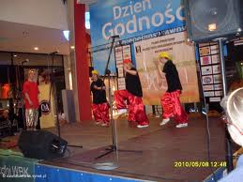
By teaching
learn to dance
Drama
aerobics

Slide 29
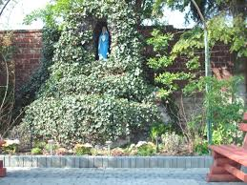
By working
working in the garden
mowing the lawn
cleaning the studio

Slide 30
Thanks for your attension !

